Slide 1


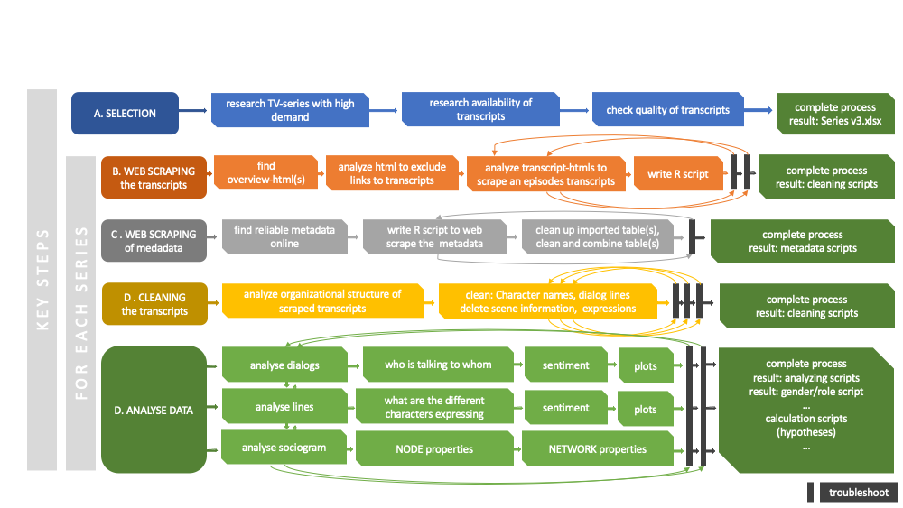






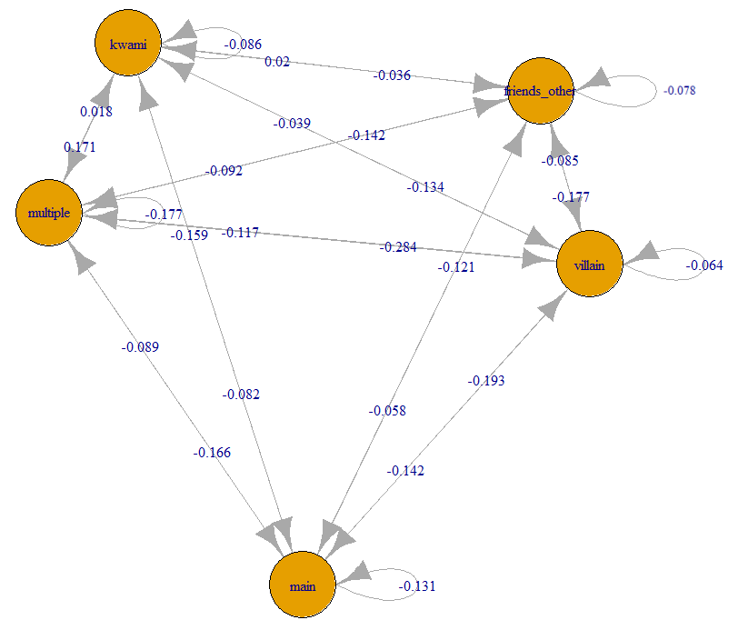
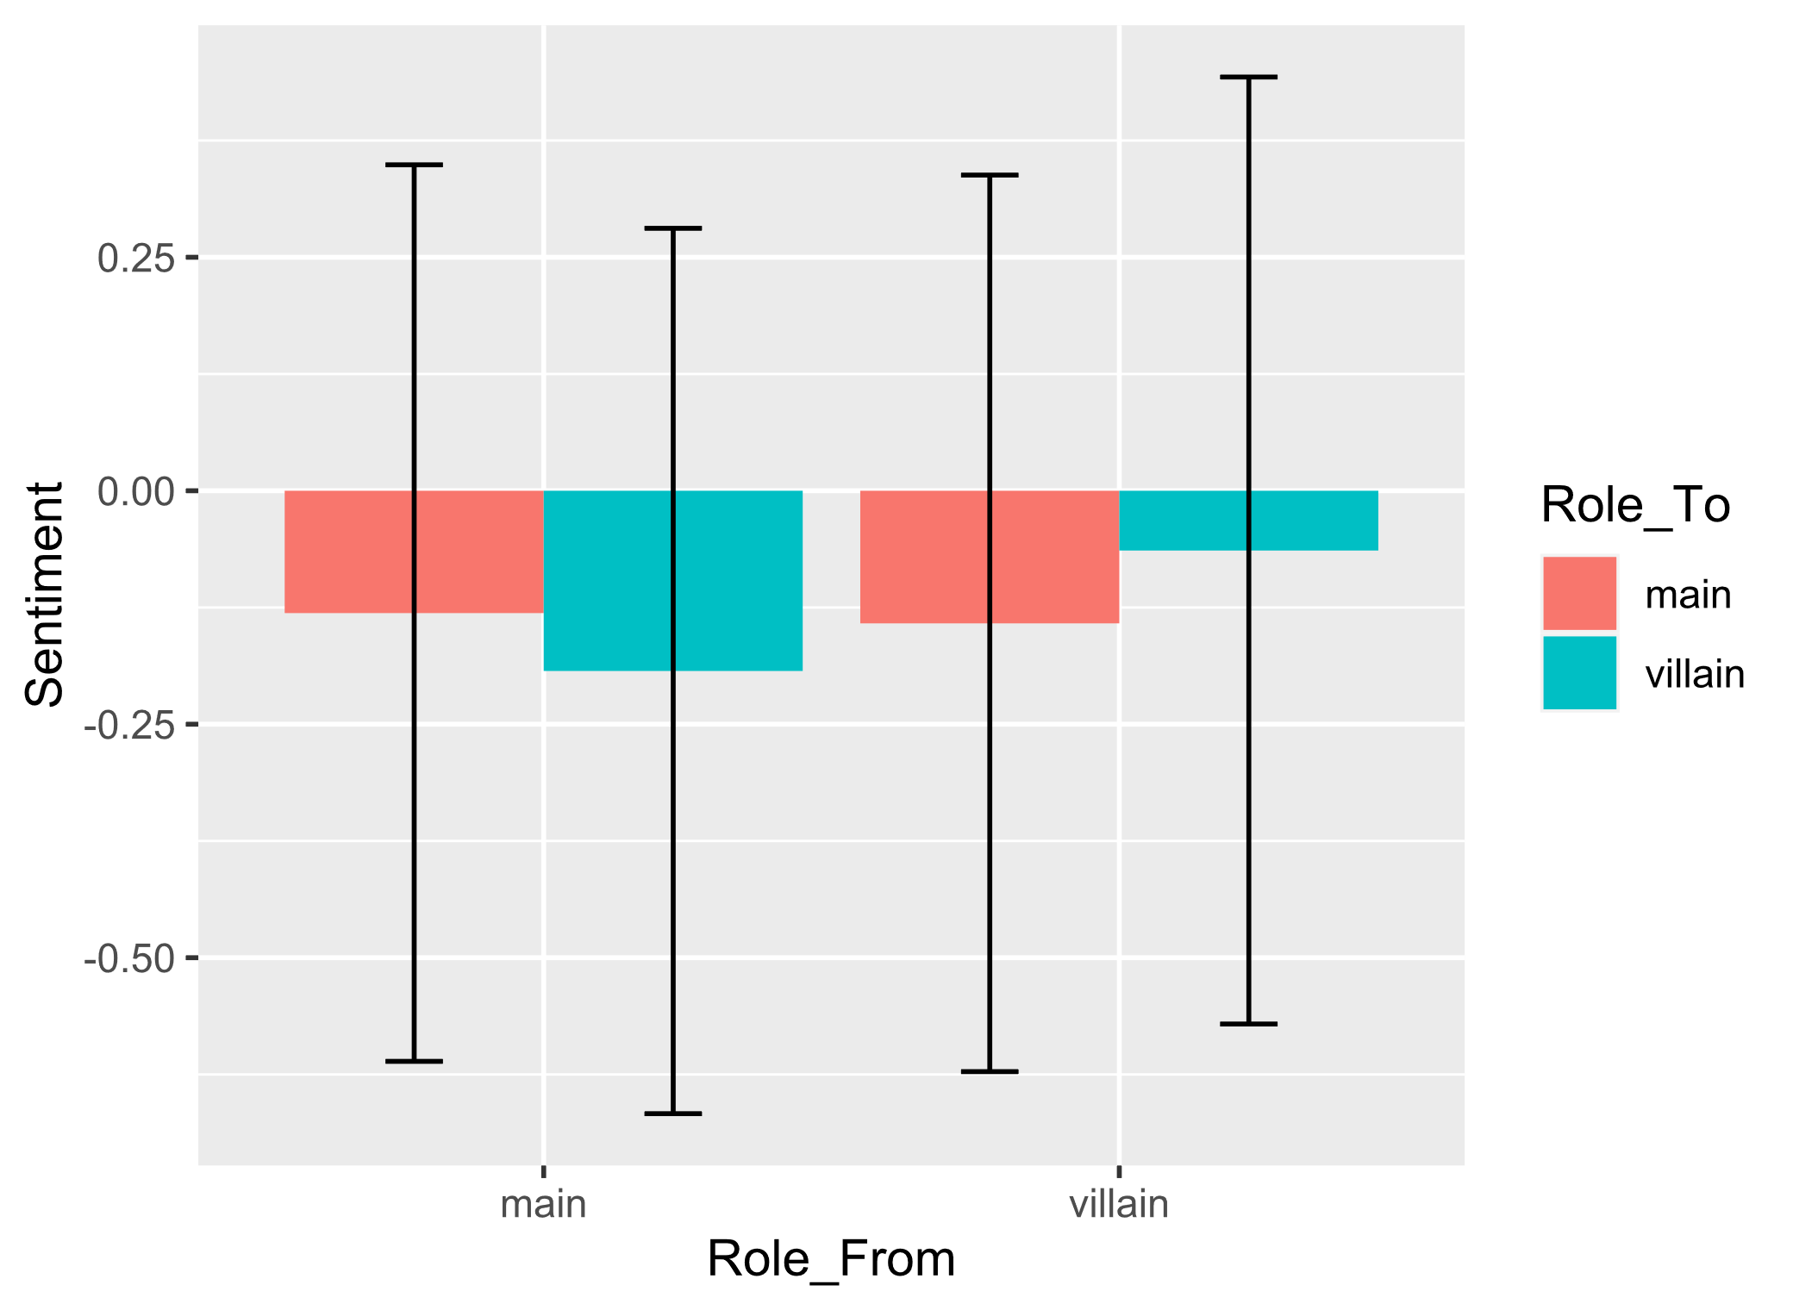


Social structures in children TV series – a network analysis
Laura Gröttrup*, Supervisor: Univ.-Prof. Dr.phil. Guilherme Maia de Oliveira Wood¹
¹University of Graz
Introduction
While in the past the amount of time children could spend watching TV was limited by the number and availability of potential series, nowadays there are hardly any limits, leading to a significant increase of screen time [1]. According to social learning theory, children observe role models in their environment and adopt the behavior practiced [2]. Since models can also be fictional like e.g. TV characters, the interaction of characters in these series is interesting since this behavior is imitated [3].
When analyzing those series a large amount of data must be screened, therefore the goal of this work was to find a computational method to model the social networks in children's series through the verbalization of the characters. Emphasis is placed on the mapping from sender to receiver and the emotional content of the communication.
The following hypotheses were to be validated:
H1 | Through the network analysis, the social roles can be identified. Specific roles such as main character and villain can be characterized by it.
H2 | Average emotional valence is associated to the thematic role (hero, villain) of each character
H3 | Main characters show the highest range in the valence of emotions between in- and out-degree
Method
The children's series "Miraculous: Tales of Ladybug & Cat Noir" was selected as a proof-of-principle. Using the statistical language R, the fan-made scripts were fetched from the internet. Four seasons were analyzed further and after cleaning, 131 transcripts of episodes containing in total 687 unique speakers remained. Metadata such as the assignment of episodes to seasons was also retrieved from Wikipedia. This was done using web scrapping and was matched with the transcripts.
As the central model communication graphs were constructed: the nodes in those graphs are the speakers, edges were defined by the temporal relation from one person to the person speaking next. This model was analyzed using existing R packages: for the calculation of the sentiment in the verbalizations of the characters the deep-learning package sentiment.ai [4] was used, for network analysis, igraph [5].
Figure 1: Research process workflow
Table 2: Network properties
Results / Conclusion
Würde ich all blocksatz formatieren…Through network analysis, it was possible to map the social structure at episode, season, and series level. Table 1 shows the different node characteristics of the characters over the entire series. The main characters were identified by the highest betweenness, meaning how often the person was part of the shortest path. Alternatively, the eigen (vector?) centrality, which assigns a weight to each edge depending on its influence, could also be used as a criterion for the selection of the main characters, but this leads only to slightly different results.
By means of the sentiment analysis in combination with the network analysis, it was possible to determine both the received and emitted sentiment values per person, per role and in the interaction. Figure 2 shows the interaction between the different roles together with sentiment. It was found that heroes talk to villains with a significantly more negative sentiment than when villains talk to heroes, ich glaub das müsste heißen: It was found that heros talk with to sign. more negative sentiment than villians do – weil Role to nicht significant war, ist es egal zu wem gesprochen wird. (see Table 3). Ich würde Table 3 herausnehmen, da es die Ergebnisse der ANOVA, nicht aber der Mittelwertsvergleich zeigt, (das wären die posttests). Die Ergebnisse der ANOVA kannst aber angeben, der effect den du nennst könntest du so angeben: (F(1) = [20.004], p < 0.01) . Du hast aber noch mehr effecte, nämlich in der interaction: twa6_pht2. willst du diese nicht angeben?
Takeaway: The method described is applicable for the analysis of social network structures and the interaction between characters and roles exemplified by children's series. For application to several series the quality of the transcripts must be ensured.
Attribute
Betweenness | 106480 | 99440 | 55909 | 54010 | 51233
Degree – In | 270 | 238 | 194 | 134 | 148
Degree - Out | 274 | 227 | 195 | 161 | 161
Eigen centrality | 1 | 0.46 | 0.95 | 0.28 | 0.12
Hub score | 1 | 0.46 | 0.9 | 0.28 | 0.1
Authority score | 1 | 0.46 | 0.97 | 0.29 | 0.12
Name | Graph value whole serie | Mean over episodes
Diameter | 19 | 10.5
Edge Density | 0.01 | 0.15
Reciprocity | 0.62 | 0.6
Assortativity | -0.31 | -0.17
Table 1: Node properties for the five characters with the most betweenness
Figure 3: Sentiment villain - hero with standard deviation for Anova
 | DF | Sum Sq | Mean Sq | F value | Eta Square
Role_From | 1 | 4 | 4.447 | 4.590 | 0.0000565
Role_To | 1 | 1 | 1.452 | 1.499 | 0.00203
Role_From:Role_To | 1 | 19 | 19.381 | 20.004 | 0.00327
Residuals | 6106 | 5916 | 0.969
Figure 2: Sociogram between roles with sentiment
Table 3: Results two-way Anova
References:
[1] Chen W., Adler J. (2019). Assessment of Screen Exposure in Young Children, 1997 to 2014. JAMA Pediatr. 2019;173(4):391–393. doi:10.1001/jamapediatrics.2018.5546
[2] Bandura A. (1969). Social-learning theory of identificatory processes. Handbook of socialization theory andresearch, 213, 262
[3] Meltzoff A. N. (1988). Imitation of televised models by infants. Child development, 59(5), 1221–1229. https://doi.org/10.1111/j.1467-8624.1988.tb01491.x,
[4] Csardi G, Nepusz T (2006). The igraph software package for complex network research. InterJournal, Complex Systems, 1695. https://igraph.org.
[5] Wiseman B., Nydick S., Wisner T. (2019). sentiment.ai: Simple Sentiment Analysis Using Deep Learning, https://benwiseman.github.io/sentiment.ai/
*Corresponding author: laura.groettrup@tu-graz.at

